Slide 1
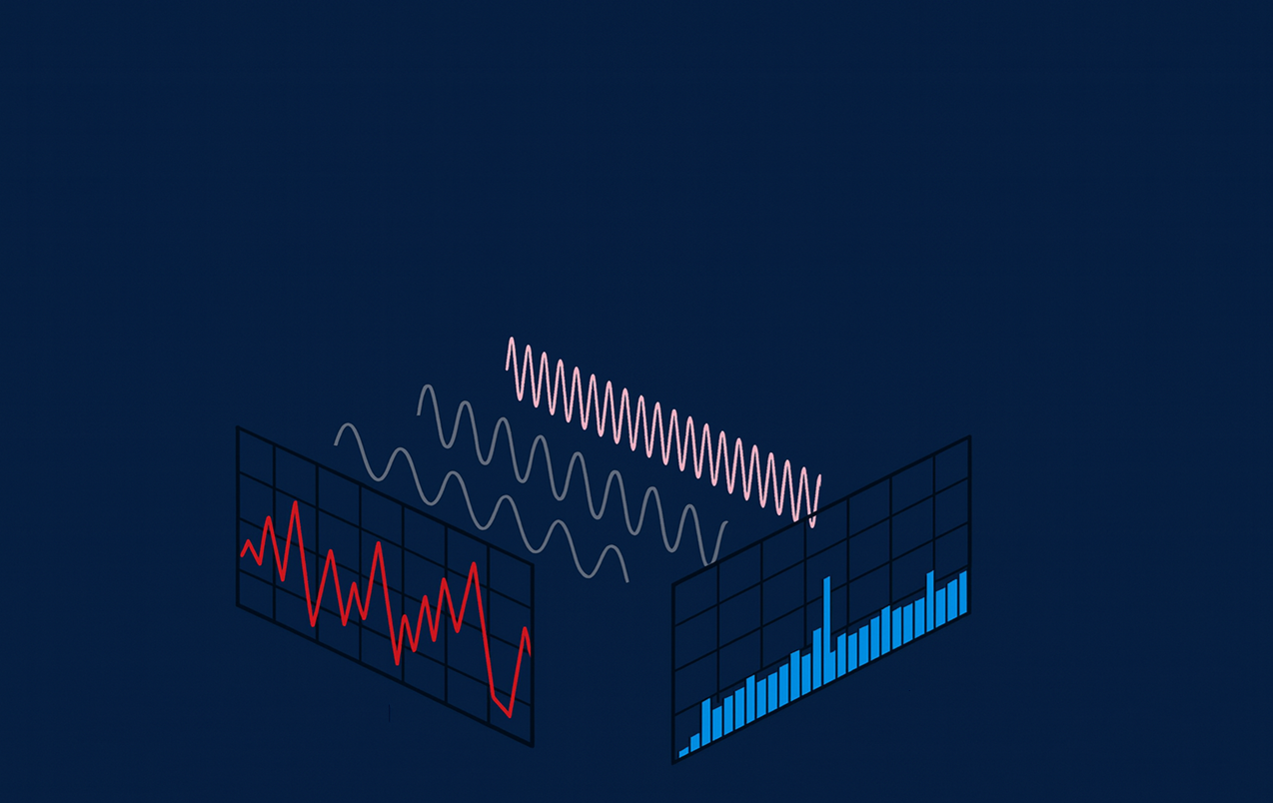
ARM DSP Core
DSP Enhanced arm M4 FFT

Slide 2

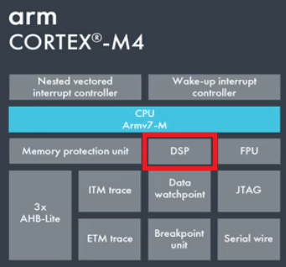
Topics
Time-domain / Frequency-Domain
Recap of DFT and FFT
Building a Frequency Decomposition Machine
-DFT
-FFT by means of periodicity and symmetry
The butterfly and its cost
Memory constraints – in place DIT
Implementation
What to expect
Leakage and windows

